Slide 1
ICPT – Concepten in Programmeertalen
Les 5
Object georiënteerd programmeren
Concurrency
Exception Handling

Slide 2
Planning voor vandaag
Object georiënteerd programmeren
Pauze
Concurrency
Exception Handling

Slide 3
Chapter 12
Support for
Object-Oriented Programming

Slide 4
Chapter 12 Topics
Introduction
Object-Oriented Programming
Design Issues for Object-Oriented Languages
Support for Object-Oriented Programming in Smalltalk
Support for Object-Oriented Programming in C++
Support for Object-Oriented Programming in Objective-C
Support for Object-Oriented Programming in Java
Support for Object-Oriented Programming in C#
Support for Object-Oriented Programming in Ruby
Implementation of Object-Oriented Constructs

Slide 5
Introduction
Many object-oriented programming (OOP) languages
Some support procedural and data-oriented programming (e.g., Ada 95+ and C++)
Some support functional program (e.g., CLOS)
Newer languages do not support other paradigms but use their imperative structures (e.g., Java and C#)
Some are pure OOP language (e.g., Smalltalk & Ruby)
Some functional languages support OOP, but they are not discussed in this chapter

Slide 6
Object-Oriented Programming
Three major language features:
Abstract data types (Chapter 11)
Inheritance
Inheritance is the central theme in OOP and languages that support it
Polymorphism

Slide 7
Inheritance
Productivity increases can come from reuse
ADTs are difficult to reuse—always need changes
All ADTs are independent and at the same level
Inheritance allows new classes defined in terms of existing ones, i.e., by allowing them to inherit common parts
Inheritance addresses both of the above concerns--reuse ADTs after minor changes and define classes in a hierarchy

Slide 8
Object-Oriented Concepts
ADTs are usually called classes
Class instances are called objects
A class that inherits is a derived class or a subclass
The class from which another class inherits is a parent class or superclass
Subprograms that define operations on objects are called methods

Slide 9
Object-Oriented Concepts (continued)
Calls to methods are called messages
The entire collection of methods of an object is called its message protocol or message interface
Messages have two parts--a method name and the destination object
In the simplest case, a class inherits all of the entities of its parent

Slide 10
Object-Oriented Concepts (continued)
Inheritance can be complicated by access controls to encapsulated entities
A class can hide entities from its subclasses
A class can hide entities from its clients
A class can also hide entities for its clients while allowing its subclasses to see them
Besides inheriting methods as is, a class can modify an inherited method
The new one overrides the inherited one
The method in the parent is overriden

Slide 11
Object-Oriented Concepts (continued)
Three ways a class can differ from its parent:
1. The parent class can define some of its variables or methods to have private access, which means they will not be visible in the subclass
2. The subclass can add variables and/or methods to those inherited from the parent
3. The subclass can modify the behavior of one or more of its inherited methods.

Slide 12
Object-Oriented Concepts (continued)
There are two kinds of variables in a class:
Class variables - one/class
Instance variables - one/object
There are two kinds of methods in a class:
Class methods – accept messages to the class
Instance methods – accept messages to objects
Single vs. Multiple Inheritance
One disadvantage of inheritance for reuse:
Creates interdependencies among classes that complicate maintenance

Slide 13
Dynamic Binding
A polymorphic variable can be defined in a class that is able to reference (or point to) objects of the class and objects of any of its descendants
When a class hierarchy includes classes that override methods and such methods are called through a polymorphic variable, the binding to the correct method will be dynamic
Allows software systems to be more easily extended during both development and maintenance

Slide 14
Dynamic Binding Concepts
An abstract method is one that does not include a definition (it only defines a protocol)
An abstract class is one that includes at least one virtual method
An abstract class cannot be instantiated

Slide 15
Design Issues for OOP Languages
The Exclusivity of Objects
Are Subclasses Subtypes?
Single and Multiple Inheritance
Object Allocation and Deallocation
Dynamic and Static Binding
Nested Classes
Initialization of Objects

Slide 16
The Exclusivity of Objects
Everything is an object
Advantage - elegance and purity
Disadvantage - slow operations on simple objects
Add objects to a complete typing system
Advantage - fast operations on simple objects
Disadvantage - results in a confusing type system (two kinds of entities)
Include an imperative-style typing system for primitives but make everything else objects
Advantage - fast operations on simple objects and a relatively small typing system
Disadvantage - still some confusion because of the two type systems

Slide 17
Are Subclasses Subtypes?
Does an “is-a” relationship hold between a parent class object and an object of the subclass?
If a derived class is-a parent class, then objects of the derived class must behave the same as the parent class object
A derived class is a subtype if it has an is-a relationship with its parent class
Subclass can only add variables and methods and override inherited methods in “compatible” ways

Slide 18
Single and Multiple Inheritance
Multiple inheritance allows a new class to inherit from two or more classes
Disadvantages of multiple inheritance:
Language and implementation complexity (in part due to name collisions)
Potential inefficiency - dynamic binding costs more with multiple inheritance (but not much)
Advantage:
Sometimes it is quite convenient and valuable

Slide 19
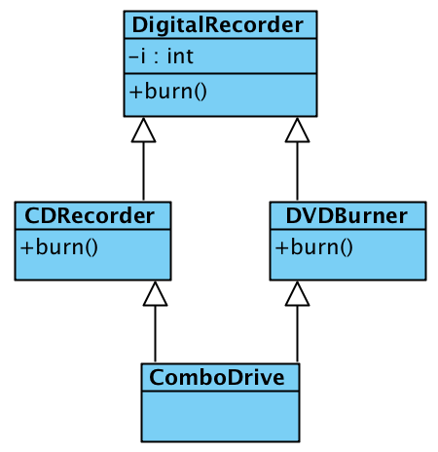
Diamond of Death (Multiple Inheritance)

Slide 20
Allocation and DeAllocation of Objects
From where are objects allocated?
If they behave like the ADTs, they can be allocated from anywhere
Allocated from the run-time stack
Explicitly create on the heap (via new)
If they are all heap-dynamic, references can be uniform thru a pointer or reference variable
Simplifies assignment - dereferencing can be implicit
If objects are stack dynamic, there is a problem with regard to subtypes – object slicing
Is deallocation explicit or implicit?

Slide 21
Dynamic and Static Binding
Should all binding of messages to methods be dynamic?
If none are, you lose the advantages of dynamic binding
If all are, it is inefficient
Does this matter for interpreted languages?
Maybe the design should allow the user to specify

Slide 22
Nested Classes
If a new class is needed by only one class, there is no reason to define so it can be seen by other classes
Can the new class be nested inside the class that uses it?
In some cases, the new class is nested inside a subprogram rather than directly in another class
Other issues:
Which facilities of the nesting class should be visible to the nested class and vice versa

Slide 23
Initialization of Objects
Are objects initialized to values when they are created?
Implicit or explicit initialization
How are parent class members initialized when a subclass object is created?

Slide 24
Support for OOP in C++
General Characteristics:
Evolved from C and SIMULA 67
Among the most widely used OOP languages
Mixed typing system
Constructors and destructors
Elaborate access controls to class entities

Slide 25
Support for OOP in C++ (continued)
Inheritance
A class need not be the subclass of any class
Access controls for members are
Private (visible only in the class and friends) (disallows subclasses from being subtypes)
Public (visible in subclasses and clients)
Protected (visible in the class and in subclasses, but not clients)

Slide 26
Support for OOP in C++ (continued)
In addition, the subclassing process can be declared with access controls (private or public), which define potential changes in access by subclasses
Private derivation - inherited public and protected members are private in the subclasses
Public derivation public and protected members are also public and protected in subclasses

Slide 27
Inheritance Example in C++
class base_class {
private:
int a;
float x;
protected:
int b;
float y;
public:
int c;
float z;
};
class subclass_1 : public base_class { … };
// In this one, b and y are protected and
// c and z are public
class subclass_2 : private base_class { … };
// In this one, b, y, c, and z are private,
// and no derived class has access to any
// member of base_class

Slide 28
Reexportation in C++
A member that is not accessible in a subclass (because of private derivation) can be declared to be visible there using the scope resolution operator (::), e.g.,
class subclass_3 : private base_class {
base_class :: c;
…
}

Slide 29
Reexportation (continued)
One motivation for using private derivation
A class provides members that must be visible, so they are defined to be public members; a derived class adds some new members, but does not want its clients to see the members of the parent class, even though they had to be public in the parent class definition

Slide 30
Support for OOP in C++ (continued)
Multiple inheritance is supported
If there are two inherited members with the same name, they can both be referenced using the scope resolution operator (::)
class Thread { ... }
class Drawing { ... }
class DrawThread : public Thread, public Drawing { … }

Slide 31
Support for OOP in C++ (continued)
Dynamic Binding
A method can be defined to be virtual, which means that they can be called through polymorphic variables and dynamically bound to messages
A pure virtual function has no definition at all
A class that has at least one pure virtual function is an abstract class

Slide 32
Support for OOP in C++ (continued)
class Shape {
public:
virtual void draw() = 0;
...
};
class Circle : public Shape {
public:
void draw() { ... }
...
};
class Rectangle : public Shape {
public:
void draw() { ... }
...
};
class Square : public Rectangle {
public:
void draw() { ... }
...
};
Square* sq = new Square;
Rectangle* rect = new Rectangle;
Shape* ptr_shape;
ptr_shape = sq; // points to a Square
ptr_shape ->draw(); // Dynamically
// bound to draw in Square
rect->draw(); // Statically bound to
// draw in Rectangle

Slide 33
Support for OOP in C++ (continued)
If objects are allocated from the stack, it is quite different
Square sq; // Allocates a Square object from the stack
Rectangle rect; // Allocates a Rectangle object from the stack
rect = sq; // Copies the data member values from sq object
rect.draw(); // Calls the draw from Rectangle

Slide 34
Support for OOP in C++ (continued)
Evaluation
C++ provides extensive access controls
C++ provides multiple inheritance
In C++, the programmer must decide at design time which methods will be statically bound and which must be dynamically bound
Static binding is faster!
Smalltalk type checking is dynamic (flexible, but somewhat unsafe)
Because of interpretation and dynamic binding, Smalltalk is ~10 times slower than C++

Slide 35
Support for OOP in Objective-C
Like C++, Objective-C adds support for OOP to C
Design was at about the same time as that of C++
Largest syntactic difference: method calls
Interface section of a class declares the instance variables and the methods
Implementation section of a class defines the methods
Classes cannot be nested

Slide 36
Support for OOP in Objective-C (continued)
Inheritance
Single inheritance only
Every class must have a parent
NSObject is the base class
@interface myNewClass: NSObject { … }
… @end
Because base class data members can be declared to be private, subclasses are not necessarily subtypes
Any method that has the same name, same return type, and same number and types of parameters as an inherited method overrides the inherited method
An overriden method can be called through super
All inheritance is public (unlike C++)

Slide 37
Support for OOP in Objective-C (continued)
Inheritance (continued)
Objective-C has two approaches besides subclassing to extend a class
A category is a secondary interface of a class that contains declarations of methods (no instance variables
#import ″Stack.h″
@interface Stack (StackExtend)
-(int) secondFromTop;
-(void) full;
@end
A category is a mixin – its methods are added to the parent class
The implementation of a category is in a separate implementation: @implementation Stack (StackExtend)

Slide 38
Support for OOP in Objective-C (continued)
Inheritance (continued)
The other way to extend a class: protocols
A protocol is a list of method declarations
@protocol MatrixOps
-(Matrix *) add: (Matrix *) mat;
-(Matrix *) subtract: (Matrix *) mat;
@optional
-(Matrix *) multiply: (Matrix *) mat;
@end
MatrixOps is the name of the protocol
The add and subtract methods must be implemented by class that uses the protocol
A class that adopts a protocol must specify it
@interface MyClass: NSObject <YourProtocol>

Slide 39
Support for OOP in Objective-C (continued)
Dynamic Binding
Different from other OOP languages – a polymorphic variable is of type id
An id type variable can reference any object
The run-time system keeps track of the type of the object that an id type variable references
If a call to a method is made through an id type variable, the binding to the method is dynamic

Slide 40
Support for OOP in Objective-C (continued)
Evaluation
Support is adequate, with the following deficiencies:
There is no way to prevent overriding an inherited method
The use of id type variables for dynamic binding is overkill – these variables could be misused
Categories and protocols are useful additions

Slide 41
Support for OOP in Java
Because of its close relationship to C++, focus is on the differences from that language
General Characteristics
All data are objects except the primitive types
All primitive types have wrapper classes that store one data value
All objects are heap-dynamic, are referenced through reference variables, and most are allocated with new
A finalize method is implicitly called when the garbage collector is about to reclaim the storage occupied by the object

Slide 42
Support for OOP in Java (continued)
Inheritance
Single inheritance supported only, but there is an abstract class category that provides some of the benefits of multiple inheritance (interface)
An interface can include only method declarations and named constants, e.g.,
public interface Comparable <T> {
public int comparedTo (T b);
}
Methods can be final (cannot be overriden)

Slide 43
Support for OOP in Java (continued)
Dynamic Binding
In Java, all messages are dynamically bound to methods, unless the method is final (i.e., it cannot be overriden, therefore dynamic binding serves no purpose)
Static binding is also used if the methods is static or private both of which disallow overriding

Slide 44
Support for OOP in Java (continued)
Nested Classes
All are hidden from all classes in their package, except for the nesting class
Nonstatic classes nested directly are called innerclasses
An innerclass can access members of its nesting class
A static nested class cannot access members of its nesting class
Nested classes can be anonymous
A local nested class is defined in a method of its nesting class
No access specifier is used

Slide 45
Support for OOP in Java (continued)
Evaluation
Design decisions to support OOP are similar to C++
No support for procedural programming
No parentless classes
Dynamic binding is used as “normal” way to bind method calls to method definitions
Uses interfaces to provide a simple form of support for multiple inheritance

Slide 46
Support for OOP in C#
General characteristics
Support for OOP similar to Java
Includes both classes and structs
Classes are similar to Java’s classes
structs are less powerful stack-dynamic constructs (e.g., no inheritance)

Slide 47
Support for OOP in C# (continued)
Inheritance
Uses the syntax of C++ for defining classes
A method inherited from parent class can be replaced in the derived class by marking its definition with new
The parent class version can still be called explicitly with the prefix base:
base.Draw()

Slide 48
Support for OOP in C#
Dynamic binding
To allow dynamic binding of method calls to methods:
The base class method is marked virtual
The corresponding methods in derived classes are marked override
Abstract methods are marked abstract and must be implemented in all subclasses
All C# classes are ultimately derived from a single root class, Object

Slide 49
Support for OOP in C# (continued)
Nested Classes
A C# class that is directly nested in a nesting class behaves like a Java static nested class
C# does not support nested classes that behave like the non-static classes of Java

Slide 50
Support for OOP in C#
Evaluation
C# is a relatively recently designed C-based OO language
The differences between C#’s and Java’s support for OOP are relatively minor

Slide 51
Support for OOP in Ruby
General Characteristics
Everything is an object
All computation is through message passing
Class definitions are executable, allowing secondary definitions to add members to existing definitions
Method definitions are also executable
All variables are type-less references to objects
Access control is different for data and methods
It is private for all data and cannot be changed
Methods can be either public, private, or protected
Method access is checked at runtime
Getters and setters can be defined by shortcuts

Slide 52
Support for OOP in Ruby (continued)
Inheritance
Access control to inherited methods can be different than in the parent class
Subclasses are not necessarily subtypes
Mixins can be created with modules, providing a kind of multiple inheritance
Dynamic Binding
All variables are typeless and polymorphic
Evaluation
Does not support abstract classes
Does not fully support multiple inheritance
Access controls are weaker than those of other languages that support OOP

Slide 53
Implementing OO Constructs
Two interesting and challenging parts
Storage structures for instance variables
Dynamic binding of messages to methods

Slide 54
Instance Data Storage
Class instance records (CIRs) store the state of an object
Static (built at compile time)
If a class has a parent, the subclass instance variables are added to the parent CIR
Because CIR is static, access to all instance variables is done as it is in records
Efficient

Slide 55
Dynamic Binding of Methods Calls
Methods in a class that are statically bound need not be involved in the CIR; methods that will be dynamically bound must have entries in the CIR
Calls to dynamically bound methods can be connected to the corresponding code thru a pointer in the CIR
The storage structure is sometimes called virtual method tables (vtable)
Method calls can be represented as offsets from the beginning of the vtable

Slide 56
Summary
OO programming involves three fundamental concepts: ADTs, inheritance, dynamic binding
Major design issues: exclusivity of objects, subclasses and subtypes, type checking and polymorphism, single and multiple inheritance, dynamic binding, explicit and implicit de-allocation of objects, and nested classes
Smalltalk is a pure OOL
C++ has two distinct type systems (hybrid)
Java is not a hybrid language like C++; it supports only OOP
C# is based on C++ and Java
Ruby is a relatively recent pure OOP language; provides some new ideas in support for OOP
Implementing OOP involves some new data structures

Slide 57
Chapter 13
Concurrency

Slide 58
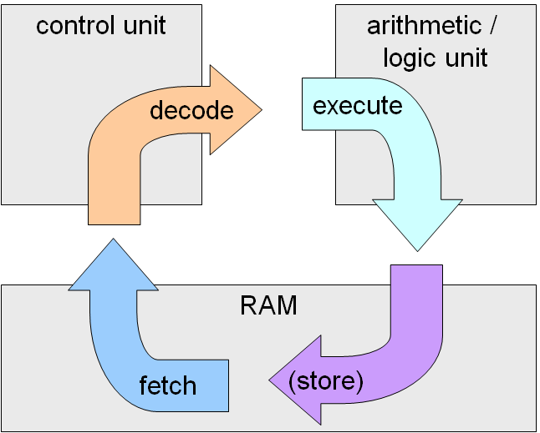
CPU and Fetch-execute cycle

Slide 59
Chapter 13 Topics
Introduction
Introduction to Subprogram-Level Concurrency
Semaphores
Monitors
Message Passing
Ada Support for Concurrency
Java Threads
C# Threads
Concurrency in Functional Languages
Statement-Level Concurrency

Slide 60
Introduction
Concurrency can occur at four levels:
Machine instruction level
High-level language statement level
Unit level
Program level
Because there are no language issues in instruction- and program-level concurrency, they are not addressed here

Slide 61
Multiprocessor Architectures
Late 1950s - one general-purpose processor and one or more special-purpose processors for input and output operations
Early 1960s - multiple complete processors, used for program-level concurrency
Mid-1960s - multiple partial processors, used for instruction-level concurrency
Single-Instruction Multiple-Data (SIMD) machines
Multiple-Instruction Multiple-Data (MIMD) machines
A primary focus of this chapter is shared memory MIMD machines (multiprocessors)

Slide 62
Categories of Concurrency
Categories of Concurrency:
Physical concurrency - Multiple independent processors ( multiple threads of control)
Logical concurrency - The appearance of physical concurrency is presented by time-sharing one processor (software can be designed as if there were multiple threads of control)
Coroutines (quasi-concurrency) have a single thread of control
A thread of control in a program is the sequence of program points reached as control flows through the program

Slide 63
Motivations for the Use of Concurrency
Multiprocessor computers capable of physical concurrency are now widely used
Even if a machine has just one processor, a program written to use concurrent execution can be faster than the same program written for nonconcurrent execution
Involves a different way of designing software that can be very useful—many real-world situations involve concurrency
Many program applications are now spread over multiple machines, either locally or over a network

Slide 64
Introduction to Subprogram-Level Concurrency
A task or process or thread is a program unit that can be in concurrent execution with other program units
Tasks differ from ordinary subprograms in that:
A task may be implicitly started
When a program unit starts the execution of a task, it is not necessarily suspended
When a task’s execution is completed, control may not return to the caller
Tasks usually work together

Slide 65
Two General Categories of Tasks
Heavyweight tasks execute in their own address space
Lightweight tasks all run in the same address space – more efficient
A task is disjoint if it does not communicate with or affect the execution of any other task in the program in any way

Slide 66
Task Synchronization
A mechanism that controls the order in which tasks execute
Two kinds of synchronization
Cooperation synchronization
Competition synchronization
Task communication is necessary for synchronization, provided by: - Shared nonlocal variables - Parameters - Message passing

Slide 67
Kinds of synchronization
Cooperation: Task A must wait for task B to complete some specific activity before task A can continue its execution, e.g., the producer-consumer problem
Competition: Two or more tasks must use some resource that cannot be simultaneously used, e.g., a shared counter
Competition is usually provided by mutually exclusive access (approaches are discussed later)

Slide 68
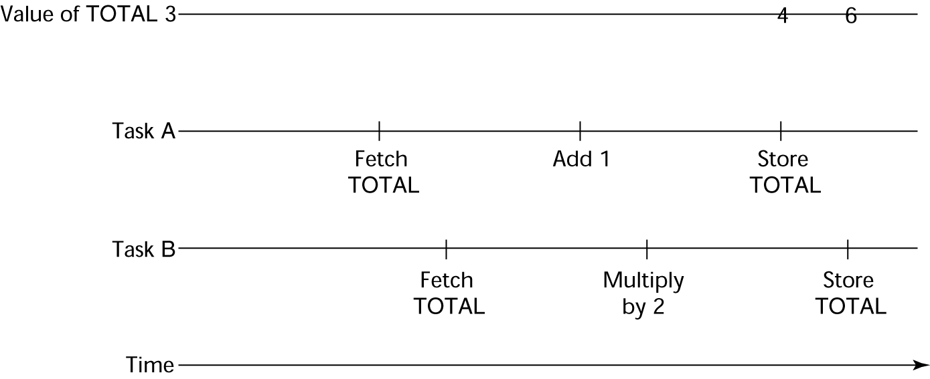
Need for Competition Synchronization
Task A: TOTAL = TOTAL + 1
Task B: TOTAL = 2 * TOTAL
- Depending on order, there could be four different results

Slide 69
Scheduler
Providing synchronization requires a mechanism for delaying task execution
Task execution control is maintained by a program called the scheduler, which maps task execution onto available processors

Slide 70
Task Execution States
New - created but not yet started
Ready - ready to run but not currently running (no available processor)
Running
Blocked - has been running, but cannot now continue (usually waiting for some event to occur)
Dead - no longer active in any sense

Slide 71
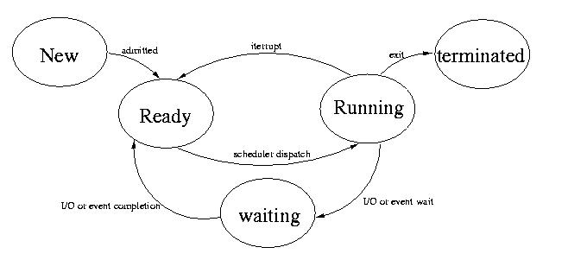
Task Execution States (continued)

Slide 72
Liveness and Deadlock
Liveness is a characteristic that a program unit may or may not have - In sequential code, it means the unit will eventually complete its execution
In a concurrent environment, a task can easily lose its liveness
If all tasks in a concurrent environment lose their liveness, it is called deadlock

Slide 73
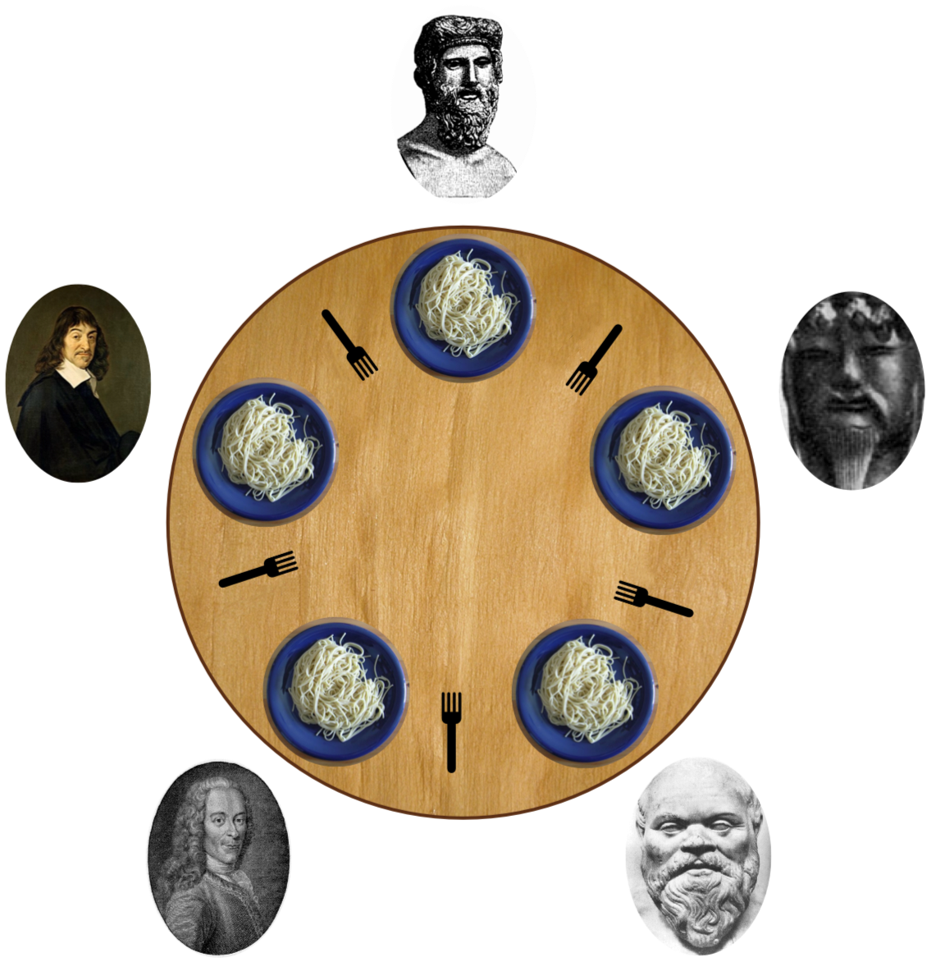
Starvation
think until the left fork is available; when it is, pick it up;
think until the right fork is available; when it is, pick it up;
when both forks are held, eat for a fixed amount of time;
then, put the right fork down;
then, put the left fork down;
repeat from the beginning.

Slide 74
Design Issues for Concurrency
Competition and cooperation synchronization*
Controlling task scheduling
How can an application influence task scheduling
How and when tasks start and end execution
How and when are tasks created
* The most important issue

Slide 75
Methods of Providing Synchronization
Semaphores
Monitors
Message Passing

Slide 76
Semaphores
Dijkstra - 1965
A semaphore is a data structure consisting of a counter and a queue for storing task descriptors
A task descriptor is a data structure that stores all of the relevant information about the execution state of the task
Semaphores can be used to implement guards on the code that accesses shared data structures
Semaphores have only two operations, wait and release (originally called P and V by Dijkstra)
Semaphores can be used to provide both competition and cooperation synchronization

Slide 77
Cooperation Synchronization with Semaphores
Example: A shared buffer
The buffer is implemented as an ADT with the operations DEPOSIT and FETCH as the only ways to access the buffer
Use two semaphores for cooperation: emptyspots and fullspots
The semaphore counters are used to store the numbers of empty spots and full spots in the buffer

Slide 78
Cooperation Synchronization with Semaphores (continued)
DEPOSIT must first check emptyspots to see if there is room in the buffer
If there is room, the counter of emptyspots is decremented and the value is inserted
If there is no room, the caller is stored in the queue of emptyspots
When DEPOSIT is finished, it must increment the counter of fullspots

Slide 79
Cooperation Synchronization with Semaphores (continued)
FETCH must first check fullspots to see if there is a value
If there is a full spot, the counter of fullspots is decremented and the value is removed
If there are no values in the buffer, the caller must be placed in the queue of fullspots
When FETCH is finished, it increments the counter of emptyspots
The operations of FETCH and DEPOSIT on the semaphores are accomplished through two semaphore operations named wait and release

Slide 80
Semaphores: Wait and Release Operations
wait(aSemaphore)
if aSemaphore’s counter > 0 then
decrement aSemaphore’s counter
else
put the caller in aSemaphore’s queue
attempt to transfer control to a ready task
-- if the task ready queue is empty,
-- deadlock occurs
end
release(aSemaphore)
if aSemaphore’s queue is empty then
increment aSemaphore’s counter
else
put the calling task in the task ready queue
transfer control to a task from aSemaphore’s queue
end

Slide 81
Producer and Consumer Tasks
semaphore fullspots, emptyspots;
fullstops.count = 0;
emptyspots.count = BUFLEN;
task producer;
loop
-- produce VALUE –-
wait (emptyspots); {wait for space}
DEPOSIT(VALUE);
release(fullspots); {increase filled}
end loop;
end producer;
task consumer;
loop
wait (fullspots);{wait till not empty}}
FETCH(VALUE);
release(emptyspots); {increase empty}
-- consume VALUE –-
end loop;
end consumer;

Slide 82
Competition Synchronization with Semaphores
A third semaphore, named access, is used to control access (competition synchronization)
The counter of access will only have the values 0 and 1
Such a semaphore is called a binary semaphore
Note that wait and release must be atomic!

Slide 83
Producer Code for Semaphores
semaphore access, fullspots, emptyspots;
access.count = 0;
fullstops.count = 0;
emptyspots.count = BUFLEN;
task producer;
loop
-- produce VALUE –-
wait(emptyspots); {wait for space}
wait(access); {wait for access)
DEPOSIT(VALUE);
release(access); {relinquish access}
release(fullspots); {increase filled}
end loop;
end producer;

Slide 84
Consumer Code for Semaphores
task consumer;
loop
wait(fullspots);{wait till not empty}
wait(access); {wait for access}
FETCH(VALUE);
release(access); {relinquish access}
release(emptyspots); {increase empty}
-- consume VALUE –-
end loop;
end consumer;

Slide 85
Evaluation of Semaphores
Misuse of semaphores can cause failures in cooperation synchronization, e.g., the buffer will overflow if the wait of fullspots is left out
Misuse of semaphores can cause failures in competition synchronization, e.g., the program will deadlock if the release of access is left out

Slide 86
Monitors
Ada, Java, C#
The idea: encapsulate the shared data and its operations to restrict access
A monitor is an abstract data type for shared data

Slide 87
Competition Synchronization
Shared data is resident in the monitor (rather than in the client units)
All access resident in the monitor
Monitor implementation guarantee synchronized access by allowing only one access at a time
Calls to monitor procedures are implicitly queued if the monitor is busy at the time of the call

Slide 88
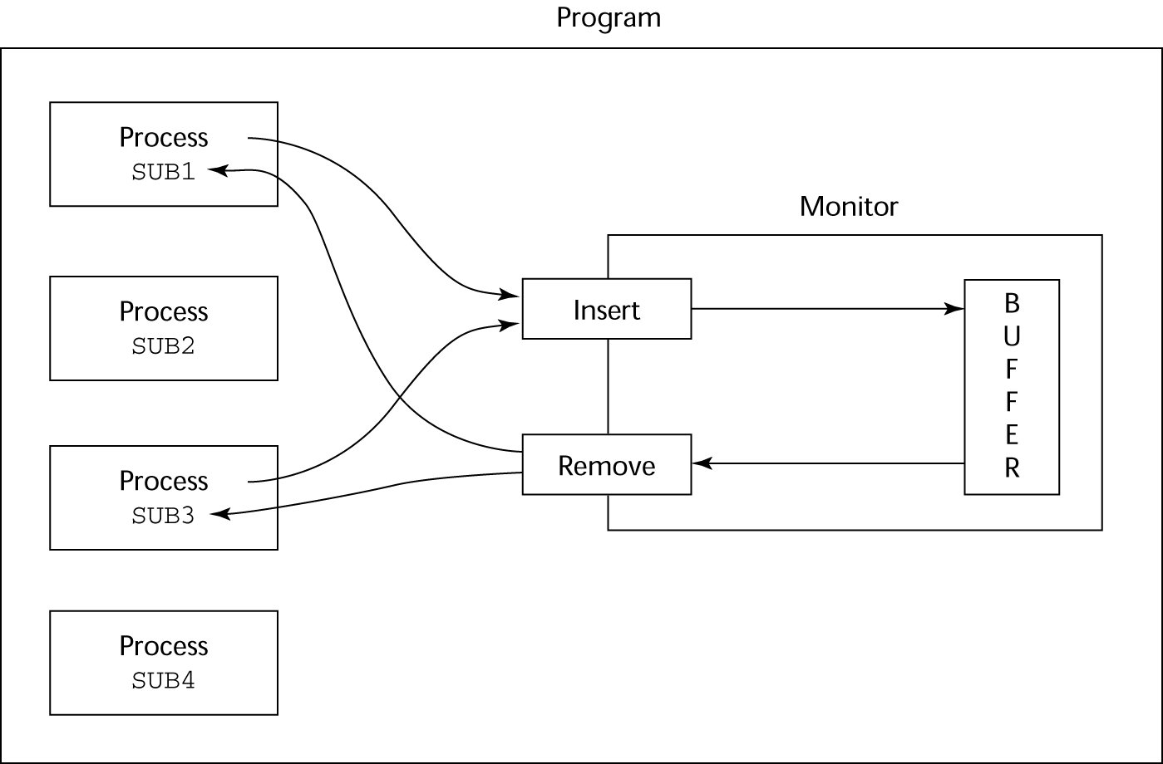
Cooperation Synchronization
Cooperation between processes is still a programming task
Programmer must guarantee that a shared buffer does not experience underflow or overflow

Slide 89
Evaluation of Monitors
A better way to provide competition synchronization than with semaphores
Semaphores can be used to implement monitors
Monitors can be used to implement semaphores
Support for cooperation synchronization is very similar as with semaphores, so it has the same problems

Slide 90
Message Passing
Message passing is a general model for concurrency
It can model both semaphores and monitors
It is not just for competition synchronization
Central idea: task communication is like seeing a doctor--most of the time she waits for you or you wait for her, but when you are both ready, you get together, or rendezvous

Slide 91
Message Passing Rendezvous
To support concurrent tasks with message passing, a language needs:
- A mechanism to allow a task to indicate when it is willing to accept messages
- A way to remember who is waiting to have its message accepted and some “fair” way of choosing the next message
When a sender task’s message is accepted by a receiver task, the actual message transmission is called a rendezvous

Slide 92
Java Threads
The concurrent units in Java are methods named run
A run method code can be in concurrent execution with other such methods
The process in which the run methods execute is called a thread
class myThread extends Thread
public void run () {…}
}
…
Thread myTh = new MyThread ();
myTh.start();

Slide 93
Controlling Thread Execution
The Thread class has several methods to control the execution of threads
The yield is a request from the running thread to voluntarily surrender the processor
The sleep method can be used by the caller of the method to block the thread
The join method is used to force a method to delay its execution until the run method of another thread has completed its execution

Slide 94
Thread Priorities
A thread’s default priority is the same as the thread that create it
If main creates a thread, its default priority is NORM_PRIORITY
Threads defined two other priority constants, MAX_PRIORITY and MIN_PRIORITY
The priority of a thread can be changed with the methods setPriority

Slide 95
Competition Synchronization with Java Threads
A method that includes the synchronized modifier disallows any other method from running on the object while it is in execution
…
public synchronized void deposit( int i) {…}
public synchronized int fetch() {…}
…
The above two methods are synchronized which prevents them from interfering with each other
If only a part of a method must be run without interference, it can be synchronized thru synchronized statement
synchronized (expression)
statement

Slide 96
Cooperation Synchronization with Java Threads
Cooperation synchronization in Java is achieved via wait, notify, and notifyAll methods
All methods are defined in Object, which is the root class in Java, so all objects inherit them
The wait method must be called in a loop
The notify method is called to tell one waiting thread that the event it was waiting has happened
The notifyAll method awakens all of the threads on the object’s wait list

Slide 97
Java’s Thread Evaluation
Java’s support for concurrency is relatively simple but effective
Not as powerful as Ada’s tasks

Slide 98
C# Threads
Loosely based on Java but there are significant differences
Basic thread operations
Any method can run in its own thread
A thread is created by creating a Thread object
Creating a thread does not start its concurrent execution; it must be requested through the Start method
A thread can be made to wait for another thread to finish with Join
A thread can be suspended with Sleep
A thread can be terminated with Abort

Slide 99
Synchronizing Threads
Three ways to synchronize C# threads
The Interlocked class
Used when the only operations that need to be synchronized are incrementing or decrementing of an integer
The lock statement
Used to mark a critical section of code in a thread
lock (expression) {… }
The Monitor class
Provides four methods that can be used to provide more sophisticated synchronization

Slide 100
C#’s Concurrency Evaluation
An advance over Java threads, e.g., any method can run its own thread
Thread termination is cleaner than in Java
Synchronization is more sophisticated

Slide 101
Statement-Level Concurrency
Objective: Provide a mechanism that the programmer can use to inform compiler of ways it can map the program onto multiprocessor architecture
Minimize communication among processors and the memories of the other processors

Slide 102
High-Performance Fortran
A collection of extensions that allow the programmer to provide information to the compiler to help it optimize code for multiprocessor computers
Specify the number of processors, the distribution of data over the memories of those processors, and the alignment of data

Slide 103
Primary HPF Specifications
Number of processors
!HPF$ PROCESSORS procs (n)
Distribution of data
!HPF$ DISTRIBUTE (kind) ONTO procs :: identifier_list
kind can be BLOCK (distribute data to processors in blocks) or CYCLIC (distribute data to processors one element at a time)
Relate the distribution of one array with that of another
ALIGN array1_element WITH array2_element

Slide 104
Statement-Level Concurrency Example
REAL list_1(1000), list_2(1000)
INTEGER list_3(500), list_4(501)
!HPF$ PROCESSORS proc (10)
!HPF$ DISTRIBUTE (BLOCK) ONTO procs ::
list_1, list_2
!HPF$ ALIGN list_1(index) WITH
list_4 (index+1)
…
list_1 (index) = list_2(index)
list_3(index) = list_4(index+1)

Slide 105
Statement-Level Concurrency (continued)
FORALL statement is used to specify a list of statements that may be executed concurrently
FORALL (index = 1:1000)
list_1(index) = list_2(index)
Specifies that all 1,000 RHSs of the assignments can be evaluated before any assignment takes place

Slide 106
Summary
Concurrent execution can be at the instruction, statement, or subprogram level
Physical concurrency: when multiple processors are used to execute concurrent units
Logical concurrency: concurrent united are executed on a single processor
Two primary facilities to support subprogram concurrency: competition synchronization and cooperation synchronization
Mechanisms: semaphores, monitors, rendezvous, threads
High-Performance Fortran provides statements for specifying how data is to be distributed over the memory units connected to multiple processors

Slide 107
Chapter 14
Exception Handling

Slide 108
Chapter 14 Topics
Introduction to Exception Handling
Exception Handling in C++
Exception Handling in Java
Exception Handling in Python and Ruby
Introduction to Event Handling
Event Handling in Java
Event Handling in C#

Slide 109
Introduction to Exception Handling
In a language without exception handling
When an exception occurs, control goes to the operating system, where a message is displayed and the program is terminated
In a language with exception handling
Programs are allowed to trap some exceptions, thereby providing the possibility of fixing the problem and continuing

Slide 110
Basic Concepts
Many languages allow programs to trap input/output errors (including EOF)
An exception is any unusual event, either erroneous or not, detectable by either hardware or software, that may require special processing
The special processing that may be required after detection of an exception is called exception handling
The exception handling code unit is called an exception handler

Slide 111
Exception Handling Alternatives
An exception is raised when its associated event occurs
A language that does not have exception handling capabilities can still define, detect, raise, and handle exceptions (user defined, software detected)
Alternatives:
Send an auxiliary parameter or use the return value to indicate the return status of a subprogram
Pass a label parameter to all subprograms (error return is to the passed label)
Pass an exception handling subprogram to all subprograms

Slide 112
Advantages of Built-in Exception Handling
Error detection code is tedious to write and it clutters the program
Exception handling encourages programmers to consider many different possible errors
Exception propagation allows a high level of reuse of exception handling code

Slide 113
Design Issues
How and where are exception handlers specified and what is their scope?
How is an exception occurrence bound to an exception handler?
Can information about the exception be passed to the handler?
Where does execution continue, if at all, after an exception handler completes its execution? (continuation vs. resumption)
Is some form of finalization provided?

Slide 114
Design Issues (continued)
How are user-defined exceptions specified?
Should there be default exception handlers for programs that do not provide their own?
Can predefined exceptions be explicitly raised?
Are hardware-detectable errors treated as exceptions that can be handled?
Are there any predefined exceptions?
How can exceptions be disabled, if at all?

Slide 115
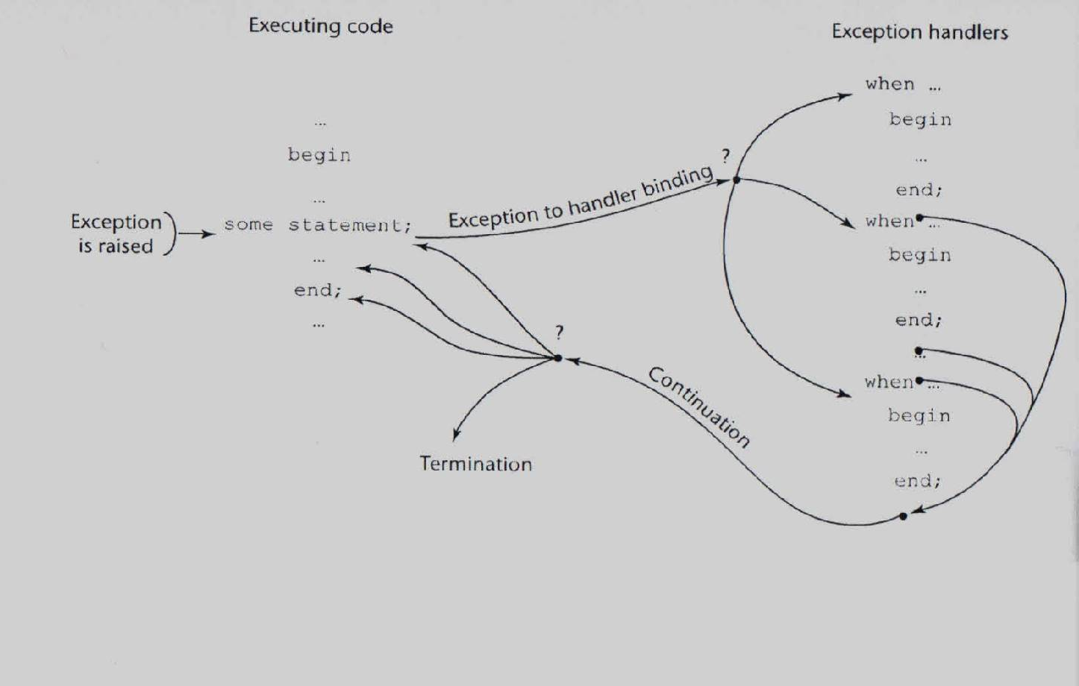
Exception Handling Control Flow

Slide 116
Exception Handling in C++
Added to C++ in 1990
Design is based on that of CLU, Ada, and ML

Slide 117
C++ Exception Handlers
Exception Handlers Form:
try {
-- code that is expected to raise an exception
}
catch (formal parameter) {
-- handler code
}
...
catch (formal parameter) {
-- handler code
}

Slide 118
The catch Function
catch is the name of all handlers--it is an overloaded name, so the formal parameter of each must be unique
The formal parameter need not have a variable
It can be simply a type name to distinguish the handler it is in from others
The formal parameter can be used to transfer information to the handler
The formal parameter can be an ellipsis, in which case it handles all exceptions not yet handled

Slide 119
Throwing Exceptions
Exceptions are all raised explicitly by the statement:
throw [expression];
The brackets are metasymbols
A throw without an operand can only appear in a handler; when it appears, it simply re-raises the exception, which is then handled elsewhere
The type of the expression disambiguates the intended handler

Slide 120
Unhandled Exceptions
An unhandled exception is propagated to the caller of the function in which it is raised
This propagation continues to the main function
If no handler is found, the default handler is called

Slide 121
Continuation
After a handler completes its execution, control flows to the first statement after the last handler in the sequence of handlers of which it is an element
Other design choices
All exceptions are user-defined
Exceptions are neither specified nor declared
The default handler, unexpected, simply terminates the program; unexpected can be redefined by the user
Functions can list the exceptions they may raise
Without a specification, a function can raise any exception (the throw clause)

Slide 122
Evaluation
There are no predefined exceptions
It is odd that exceptions are not named and that hardware- and system software-detectable exceptions cannot be handled
Binding exceptions to handlers through the type of the parameter certainly does not promote readability

Slide 123
Exception Handling in Java
Based on that of C++, but more in line with OOP philosophy
All exceptions are objects of classes that are descendants of the Throwable class

Slide 124
Classes of Exceptions
The Java library includes two subclasses of Throwable :
Error
Thrown by the Java interpreter for events such as heap overflow
Never handled by user programs
Exception
User-defined exceptions are usually subclasses of this
Has two predefined subclasses, IOException and RuntimeException (e.g., ArrayIndexOutOfBoundsException and NullPointerException

Slide 125
Java Exception Handlers
Like those of C++, except every catch requires a named parameter and all parameters must be descendants of Throwable
Syntax of try clause is exactly that of C++
Exceptions are thrown with throw, as in C++, but often the throw includes the new operator to create the object, as in: throw new MyException();

Slide 126
Binding Exceptions to Handlers
Binding an exception to a handler is simpler in Java than it is in C++
An exception is bound to the first handler with a parameter is the same class as the thrown object or an ancestor of it
An exception can be handled and rethrown by including a throw in the handler (a handler could also throw a different exception)

Slide 127
Continuation
If no handler is found in the try construct, the search is continued in the nearest enclosing try construct, etc.
If no handler is found in the method, the exception is propagated to the method’s caller
If no handler is found (all the way to main), the program is terminated
To insure that all exceptions are caught, a handler can be included in any try construct that catches all exceptions
Simply use an Exception class parameter
Of course, it must be the last in the try construct

Slide 128
Checked and Unchecked Exceptions
The Java throws clause is quite different from the throw clause of C++
Exceptions of class Error and RunTimeException and all of their descendants are called unchecked exceptions; all other exceptions are called checked exceptions
Checked exceptions that may be thrown by a method must be either:
Listed in the throws clause, or
Handled in the method

Slide 129
Other Design Choices
A method cannot declare more exceptions in its throws clause than the method it overrides
A method that calls a method that lists a particular checked exception in its throws clause has three alternatives for dealing with that exception:
Catch and handle the exception
Catch the exception and throw an exception that is listed in its own throws clause
Declare it in its throws clause and do not handle it

Slide 130
The finally Clause
Can appear at the end of a try construct
Form:
finally {
...
}
Purpose: To specify code that is to be executed, regardless of what happens in the try construct

Slide 131
Example
A try construct with a finally clause can be used outside exception handling
try {
for (index = 0; index < 100; index++) {
…
if (…) {
return;
} //** end of if
} //** end of try clause
finally {
…
} //** end of try construct

Slide 132
Assertions
Statements in the program declaring a boolean expression regarding the current state of the computation
When evaluated to true nothing happens
When evaluated to false an AssertionError exception is thrown
Can be disabled during runtime without program modification or recompilation
Two forms
assert condition;
assert condition: expression;

Slide 133
Evaluation
The types of exceptions makes more sense than in the case of C++
The throws clause is better than that of C++ (The throw clause in C++ says little to the programmer)
The finally clause is often useful
The Java interpreter throws a variety of exceptions that can be handled by user programs

Slide 134
Exception Handling in Python
Exceptions are objects; the base class is BaseException
All predefined and user-defined exceptions are derived from Exception
Predefined subclasses of Exception are ArithmeticError (subclasses are OverflowError, ZeroDivisionError, and FloatingPointError) and LookupError (subclasses are IndexError and KeyError)

Slide 135
Exception Handling in Python (continued)
try:
- The try block
except Exception1:
- Handler for Exception1
except Exception2:
- Handler for Exception2
...
else:
- The else block (no exception is raised)
finally:
- the finally block (do it no matter what)

Slide 136
Exception Handling in Python (continued)
Handlers handle the named exception plus all subclasses of that exception, so if the named exception is Exception, it handlers all predefined and user-defined exceptions
Unhandled exceptions are propagated to the nearest enclosing try block; if no handler is found, the default handler is called
Raise IndexError creates an instance
The raised exception object can be gotten:
except Exception as ex_obj:

Slide 137
Exception Handling in Python (continued)
The assert statement tests its Boolean expression (first parameter) and sends its second parameter to the constructor for the exception object to be raised
assert test, data

Slide 138
Exception Handling in Ruby
Exceptions are objects
There are many predefined exceptions
All exceptions that are user handled are either StandardError class or a subclass of it
StandardError is derived from Exception, which has two methods, message and backtrace
Exceptions can be raised with raise, which often has the form:
raise ″bad parameter″ if count == 0

Slide 139
Exception Handling in Ruby (continued)
Handlers are placed at the end of a begin-end block of code; introduced by rescue
begin
- Statements in the block
rescue
- Handler
end
The block could include else and/or ensure clauses, which are like else and finally in Java

Slide 140
Exception Handling in Ruby (continued)
Unlike the other languages we have discussed, in Ruby the code that raised an exception can be rerun by placing a retry statement at the end of the handler

